Slide 1


Simplify your Code with Helmﬁle
BRADEN WRIGHT | ROOT LEVEL TECHNOLOGY

Slide 2
Why Helmﬁle?
I love Helm but if only I could ...
Setup Helm Repos
Automate something to run before / after Helm
See what’s going to change before Deploying
Manage Secrets as part of Helm Deploy
Have dependencies installed as separate Helm Deploy
Control order of my Helm chart dependencies
Template values.yaml
Get data from another source / run a script
Use Environment Variables

Slide 3
What is Helmﬁle?
Wrapper on top of Helm
No Vendor Lock-in
Golang Templating without Restrictions
https://github.com/roboll/helmﬁle

Slide 4
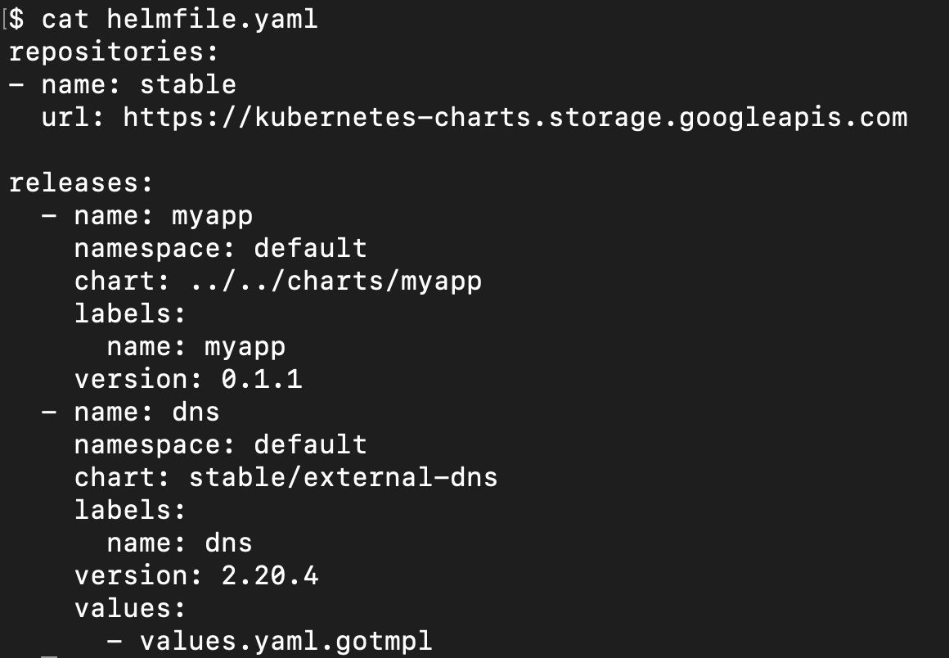
What is Helmﬁle?

Slide 5
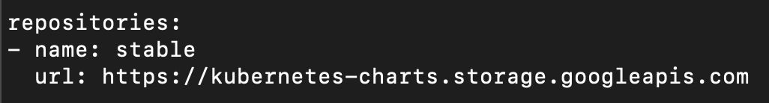
Helm missing Repos

Slide 6
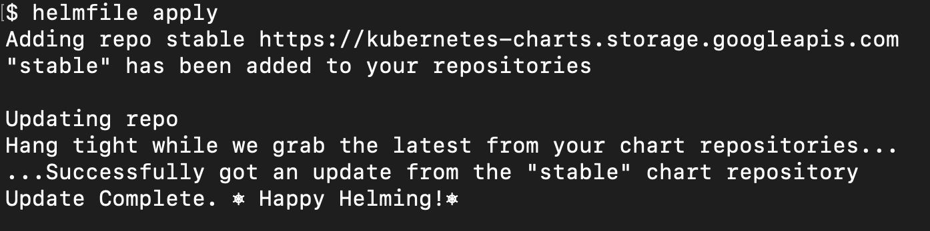
Helm missing Repos

Slide 7
Helmﬁle Hooks
Events: prepare, presync, postsync, cleanup

Slide 8
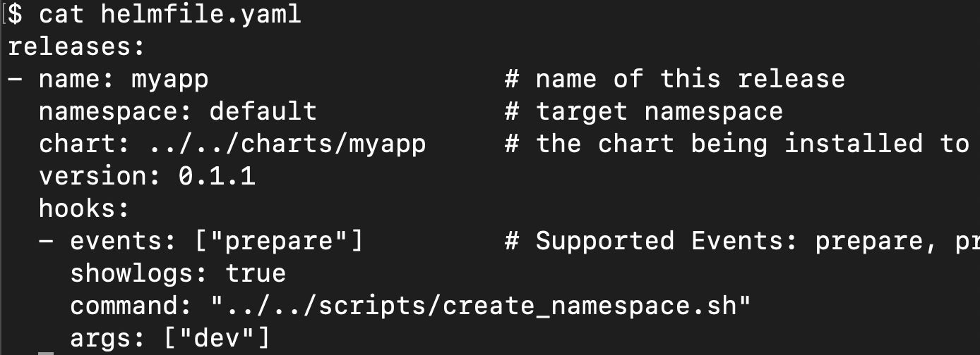
Helmﬁle Hooks
Example: create Namespace before deploying chart

Slide 9
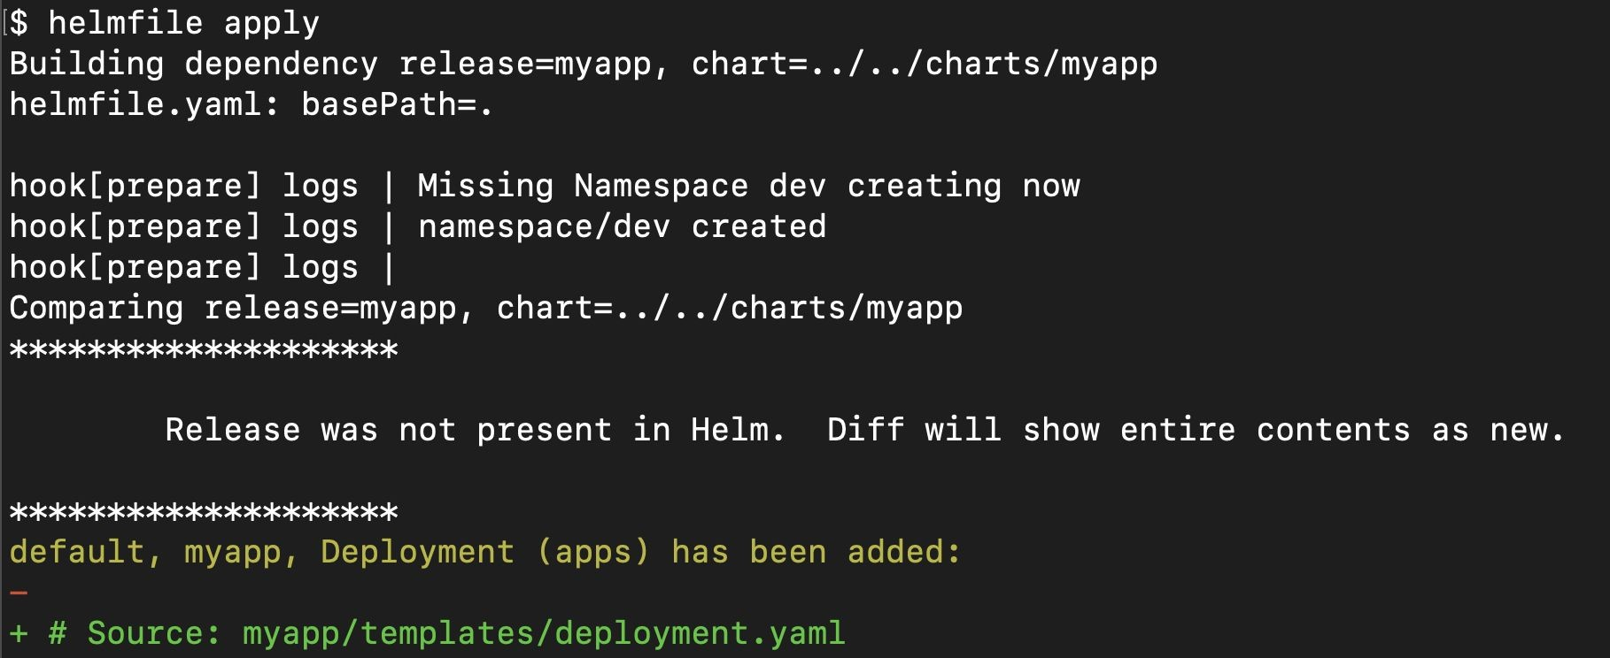
Helmﬁle Hooks
Example: create Namespace before deploying chart

Slide 10
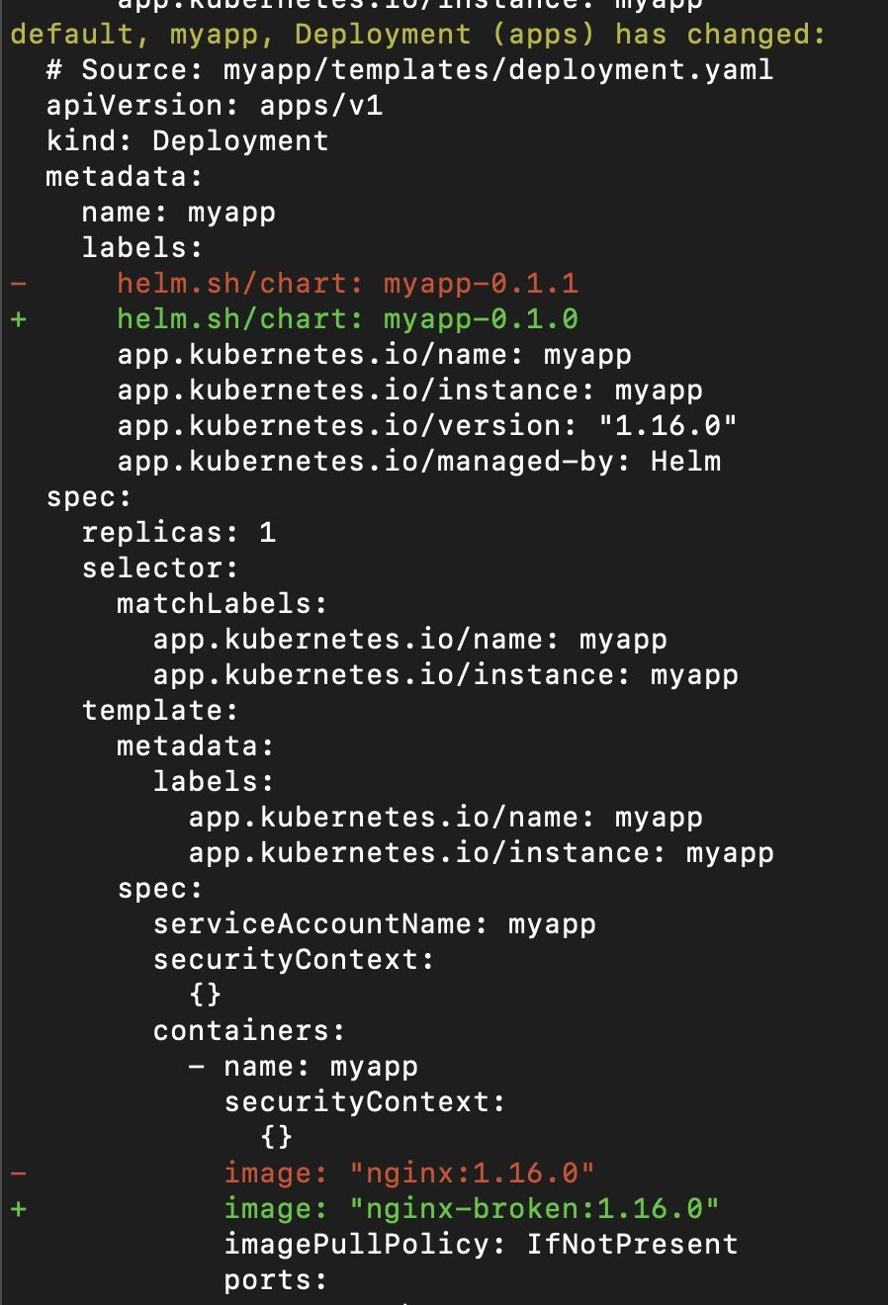
Helm Diff
Want Terraform Plan for Helm?
Bug for Helm 3, 3-way diff

Slide 11
Helm Secrets
How do you create secrets?
Where do you store sensitive data?
How do you distribute / share sensitive data?
https://github.com/zendesk/helm-secrets

Slide 12
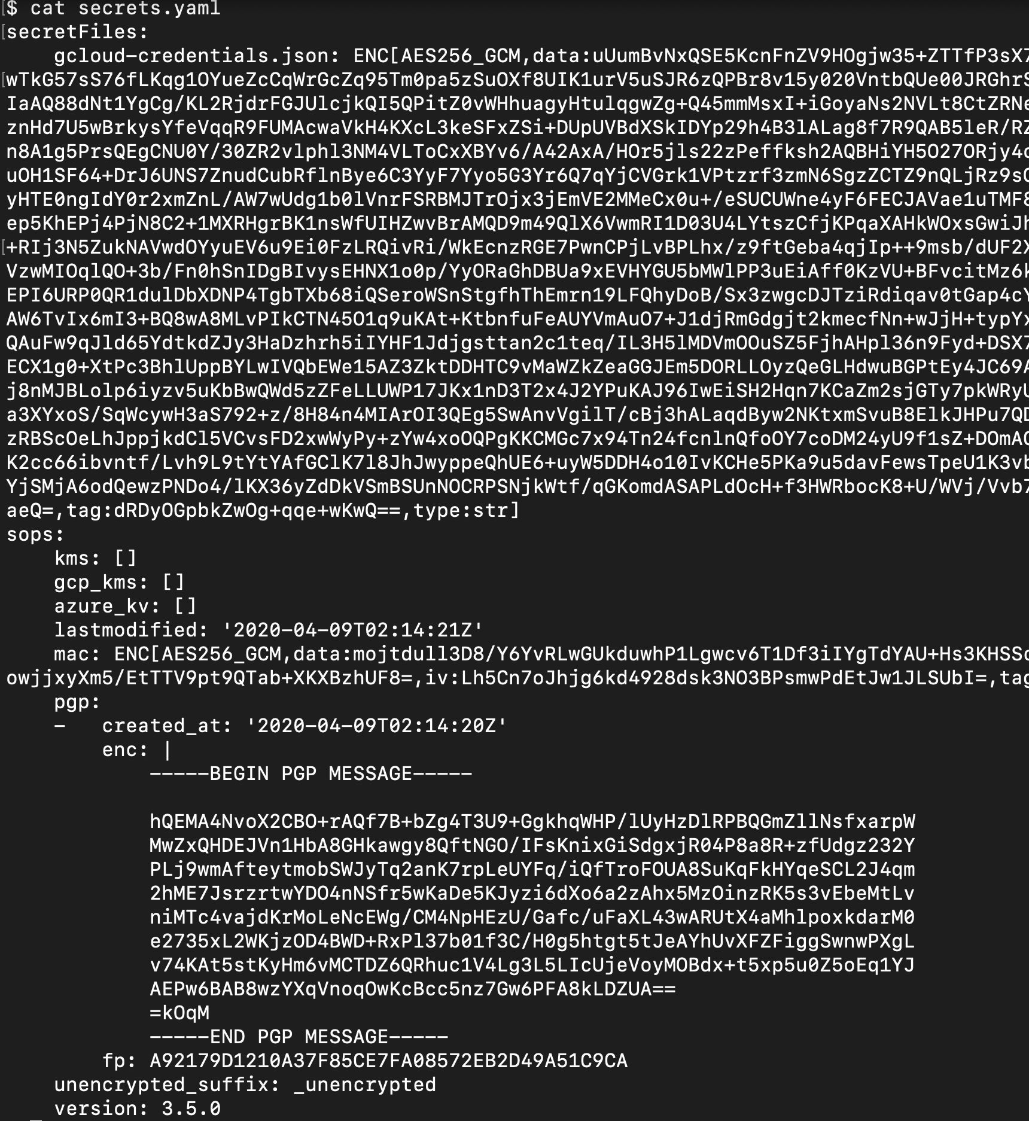
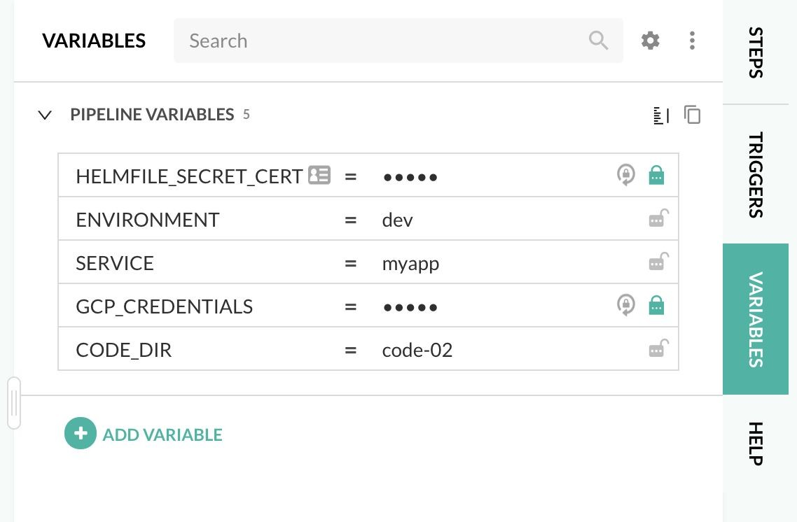
Helm Secrets

Slide 13
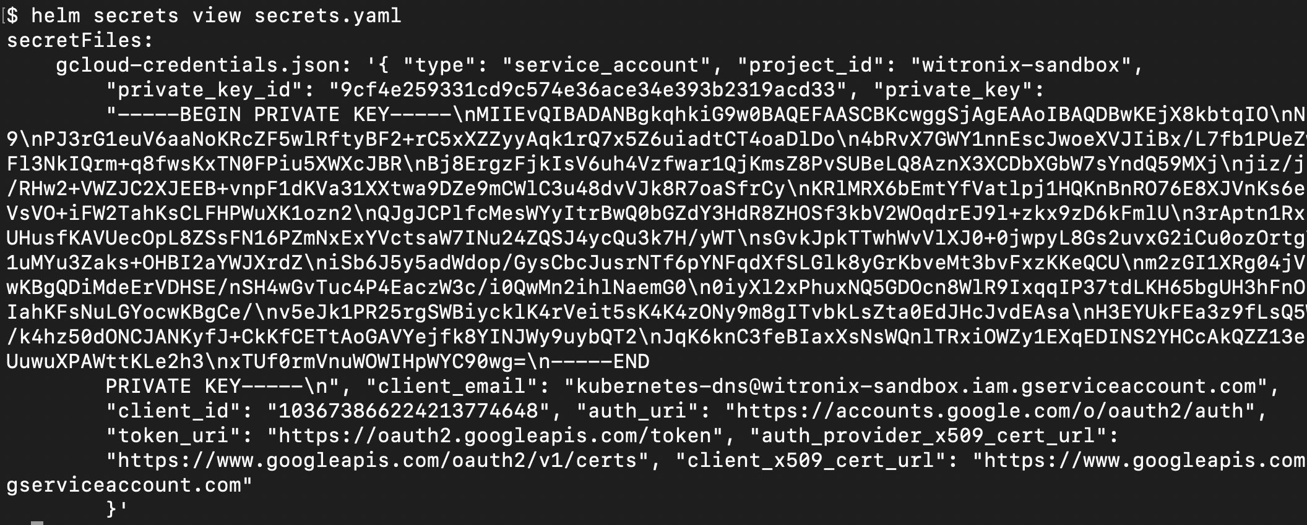
Helm Secrets

Slide 14
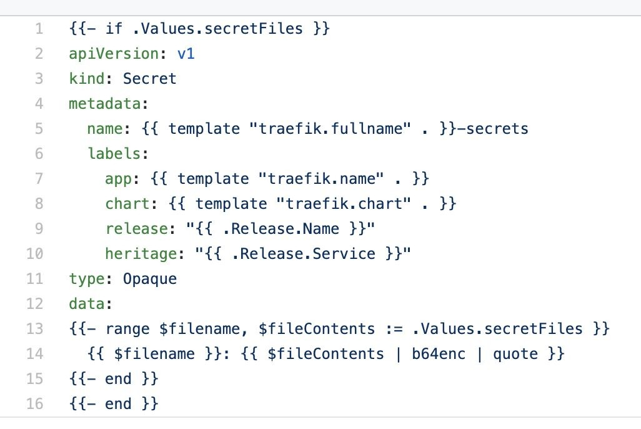
Helm Secrets

Slide 15
Helm Secrets
Helmﬁle uses Helm Secrets Plugin which uses SOPS
SOPS supports different types of Encryption
AWS KMS, GCP KMS, Azure Key Vault, PGP, etc
Secrets.yaml ﬁle gets encrypted and saved in Git
Use a Secret Resource and unencrypted Secrets.yaml to create safe, secure, reliable, repeatable and distributed way to create Resources
https://github.com/zendesk/helm-secrets https://github.com/mozilla/sops https://gist.github.com/twolfson/01d515258eef8bdbda4f

Slide 16
Order Dependencies
Runs Helm apply times
Run Helm deploy in speciﬁed order
Deploy parts of Stack using labels and selectors
Different ways to declare dependencies

Slide 17


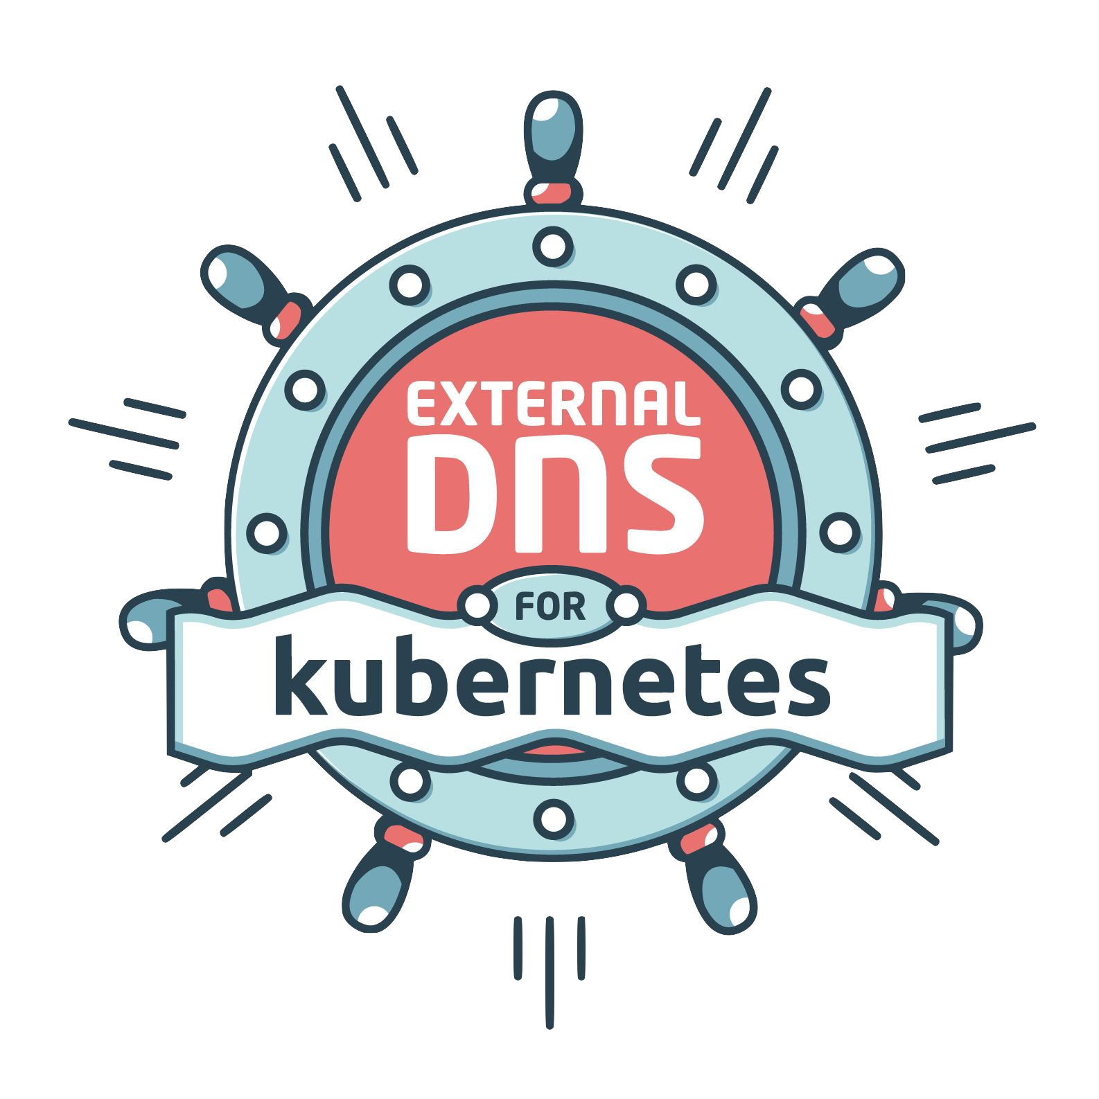


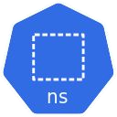

Order Dependencies
4
3
2
1

Slide 18
Demo in Codefresh
Deploy MyApp, Ingress, DNS, Namespace
Using Secrets.yaml
Started with cfstep-helmﬁle but needed to customize
https://codefresh.io/steps/step/helmﬁle

Slide 19
Templating Values Yaml Files
DRYing out values ﬁles
Use Templating to support ad-hoc environments
Hierarchy, environment level values ﬁles, with default but ability to override.
Use Env Vars in values.yaml ﬁle
Run scripts to return values
Expose all of Sprig / Go Templating
Render out other ﬁles
Use different Secrets.yaml for Different Environments

Slide 20
Demo in Codefresh
Deploy Stack in 2 Environments
Dev
DNS in GCP / CloudDNS
External DNS Chart
Default / Ad-Hoc
Leverage Templating / Script to setup an .xip.io address

Slide 21
Environments
Picture of Yaml with Multiple Environments
Setup another environment, on the same K8s cluster
Setup another environment in a different K8s cluster
Leverage Templating for Ad-Hoc environments

Slide 22
Other Helmﬁle Features
Repo Per Chart
Modules
GitHub, S3, etc.
Env Variables
Supports standard, default, required
Top Level Helmﬁle to Deploy everything
Use Helmﬁle with Kustomize

Slide 23
Mono Repo vs Repo per Chart
Talk about mono repo approach we’ve been taking, common b/c of public helms charts repo. Helmﬁle ﬂexible, so you can setup how you want to
Discuss Repo per Chart and things like getting Helmﬁle from git instead of a local ﬁle.

